Slide 1
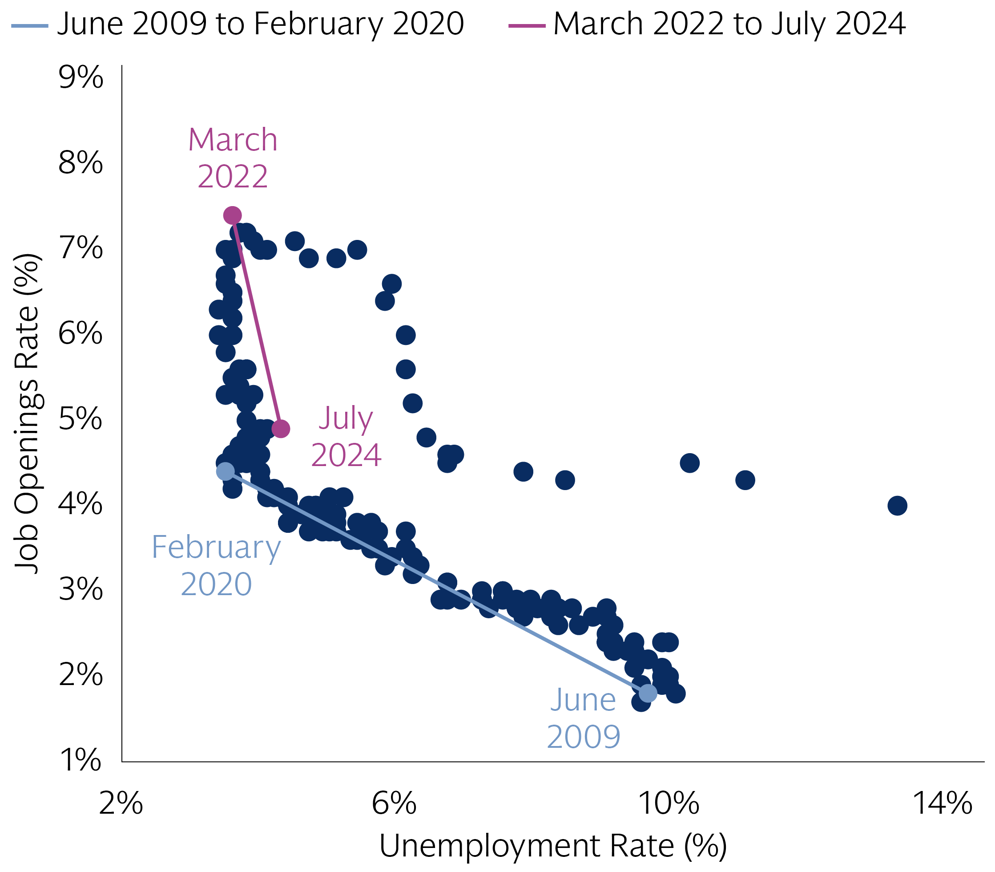
SEPTEMBER 2024
Macro views
Chart of the month¹
RECESSION RISK: Recent bouts of weakness in the US labor market have heightened fears among many investors of a potential US recession. However, our economists in GIR place the odds of a recession occurring in the next twelve months at just 20%, because 1) the rise in unemployment appears to be supply-driven, 2) GDP growth remains firm, and 3) the Fed has up to 525bps of easing capacity.
INFLATION: In the US, the soft PCE report in July and the downward revisions to the Q2 estimates should provide further evidence to the FOMC that disinflation is being sustained. Meanwhile, in the Euro area, the latest negotiated wage data showed a meaningful deceleration in Q2 suggesting that wage pressures have likely peaked.
MONETARY POLICY: Minutes from the July FOMC meeting and recent commentary from Fed Chairman Jerome Powell have further solidified the likelihood of a September cut. We expect the Fed to reduce the policy rate by just 25bps at its September meeting, barring further deterioration in the labor market. In Europe, the ECB is likely to deliver another 25bps rate cut in September while the BoE may wait until November.
US ELECTIONS: Vice President Kamala Harris has continued to gain ground on Former President Trump since becoming her party’s official nominee in August. Although we continue to see significant uncertainty around the eventual outcome of the upcoming election, Harris now leads Trump in both national and swing state polling.
MARKET VIEWS
ASSET CLASS FORECASTS²
GLOBAL EARNINGS: 2Q earnings came in better than expected in DM markets with Japanese corporates reporting bigger EPS surprises than their US and European peers. In Europe and the US, Cyclicals were the laggards, pulling Q2 beats and FY24 EPS momentum lower. In general, we conclude that consumer fears are greatly exaggerated with positive real income growth being supportive. That said, firms turned more cautious in their forward guidance citing economic and political uncertainty as key risks.
US EQUITIES: Our colleagues in GIR believe the S&P 500 is fairly valued at 5600, inclusive of 2025 earnings per share and valuation estimates of $256 and 22x, respectively. Considering current valuation levels, we expect forward equity returns to be commensurate with earnings growth over the medium-term. In the short-run, however, the top-heavy composition of the market may allow a handful of companies to drag the S&P 500 meaningfully above/below our fair value estimates. We see a near-term path up to 6300 should AI-proximate mega-cap exceptionalism continue. Conversely, should earnings, guidance, or the monetization of AI productivity falter, these same companies could pull the market lower to 4800.
VOLATILITY: August’s brief yet powerful drawdown serves as a reminder that while the macro backdrop remains supportive, other market forces can amplify price activity. These include challenged liquidity, bouts of forced selling by levered ETFs, and breaking through technical thresholds for systematic traders. While these pressures have ameliorated of late, during the August 5th selloff the market absorbed the year’s 5th highest daily volume with its single lowest daily liquidity.
 | Current | 3m | 12m | % ∆ to 12m
EQUITIES
S&P 500 ($) | 5648 | 5400 | 5700 | 0.9
STOXX Europe (€) | 525 | 510 | 540 | 2.8
MSCI Asia-Pacific Ex-Japan ($) | 577 | 550 | 615 | 6.5
TOPIX (¥) | 2713 | 2700 | 2900 | 6.9
RATES
10-Year Treasury | 3.9 | 4.3 | 4.2 | 25 bp
10-Year Bund | 2.3 | 2.3 | 2.1 | -16 bp
10-Year JGB | 0.9 | 1.2 | 1.7 | 78 bp
CURRENCIES
Euro (€/$) | 1.11 | 1.05 | 1.08 | -2.3
Pound (£/$) | 1.31 | 1.27 | 1.32 | 0.5
Yen ($/¥) | 146 | 155 | 150 | 2.8
REAL ASSETS
Brent Crude Oil ($/bbl) | 78.8 | 81 | 77 | -2.3
London Gold ($/troy oz) | 2505 | 2600 | 2700 | 7.8
Source: MSCI, GS Global Investment Research (GIR), and Goldman Sachs Asset Management. As of September 2, 2024. “We/Our” refers to Goldman Sachs Asset Management. The Macro and Market Views expressed may differ from those of GIR and other divisions of Goldman Sachs and its affiliates. See page 4 for additional disclosures. The economic and market forecasts presented herein are for informational purposes as of the date of this document. There can be no assurance that the forecasts will be achieved. Past performance does not guarantee future results, which may vary.
FOR INSTITUTIONAL OR FINANCIAL INTERMEDIARIES USE ONLY – NOT FOR USE AND/OR DISTRIBUTION TO THE GENERAL PUBLIC

Slide 2
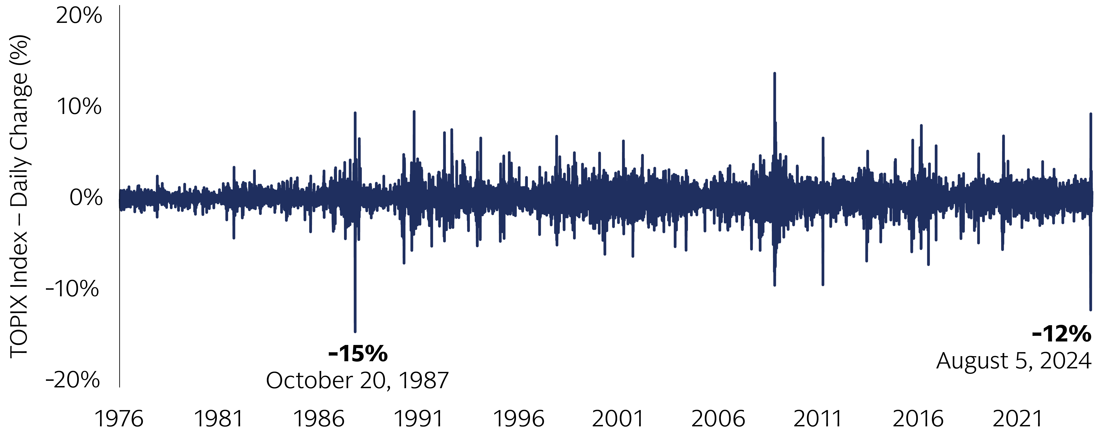
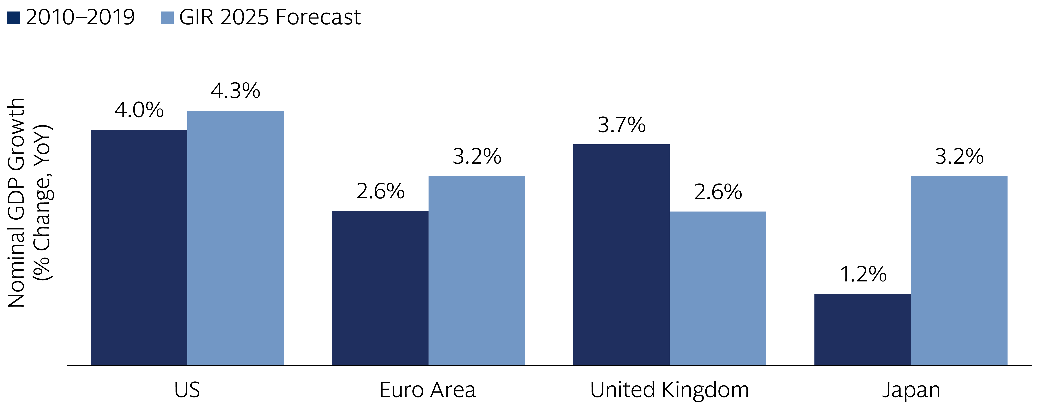
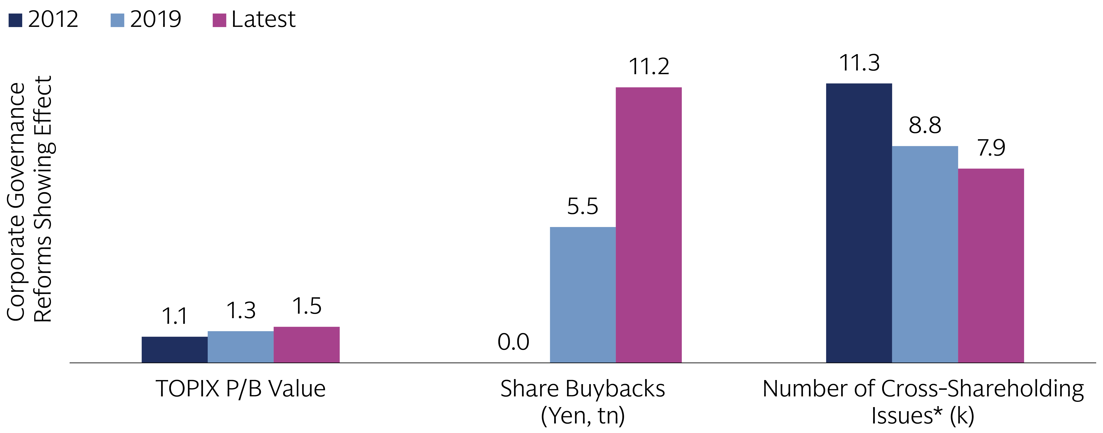
MARKET PULSE: SEPTEMBER 2024
Sun Still Rising on Japanese Equities
The unwinding of yen carry trades has weighed on Japanese equities recently, prompting the largest daily sell-off since 1987. While further strengthening of the yen and the uncertainty around a general election may result in continued market volatility, we think that the case for a strategic allocation to Japanese equities remains strong. The Japanese economy is experiencing a new dawn, which coupled with ongoing corporate governance reforms, should provide support to Japanese equities, especially those which are domestically-orientated.
Down, not out
Japanese equities suffered one of their worst days in history at the start of August, as the combination of weaker US macro data and a hawkish BoJ prompted the unwinding of carry trades with the yen as the funding currency. Since then, the Topix has recouped most of its losses and is now shy of its all-time high on July 11. While the yen is likely to appreciate further which could be a headwind, the fundamental case to owning Japanese equities remains intact, in our view.
Source: Macrobond, and Goldman Sachs Asset Management.
A new dawn for the economy
After experiencing three decades of low growth and deflation, we believe Japan economy is undergoing a structural shift led by a positive loop of rising wages and prices. Private consumption increased for the first time in five quarters in Q2, and we expect it to continue to recover, supported by improvements in real wages, and income tax cuts. This should help boost Japanese equities, especially those more domestically-exposed.
Source: Goldman Sachs Global Investment Research, and Goldman Sachs Asset Management.
Increasing corporate value
Alongside an improving macro backdrop, the Tokyo Stock Exchange is pursuing corporate governance reforms aimed at increasing corporate value. Progress has been remarkable so far, especially in the Prime segment, but there is more room for improvement. We believe that Japanese companies will be increasingly focused on returning value to their shareholders, via share buybacks and the unwinding of cross-shareholdings. This is likely to attract more investors into the market.
Source: Bloomberg, Daiwa Institute of Research, and Goldman Sachs Asset Management
“We/Our” refers to Goldman Sachs Asset Management. Top Section Notes: Source: Macrobond and Goldman Sachs Asset Management. As of August 28, 2024. Middle Section Notes: Source: Goldman Sachs Global Investment Research and Goldman Sachs Asset Management. As of August 28, 2024. Bottom Section Notes: Bloomberg, Daiwa Institute of Research, and Goldman Sachs Asset Management. As of August 28, 2024. The latest TOPIX P/B Value data is as of July 31, 2024, and the latest Share Buybacks (Yen, tn) data is annualized with the existing 2024 data. *Latest data for the number of cross-shareholdings issues is as of December 2022. The economic and market forecasts presented herein are for informational purposes as of the date of this document. There is no guarantee that objectives will be met. There can be no assurance that forecasts will be achieved. Please see additional disclosures at the end of this document. Past performance does not guarantee future results, which may vary.
FOR INSTITUTIONAL OR FINANCIAL INTERMEDIARIES USE ONLY – NOT FOR USE AND/OR DISTRIBUTION TO THE GENERAL PUBLIC
Notes:
https://publishing.gs.com/content/research/en/reports/2023/10/02/83fd319b-c066-4a6a-8fa4-b176001dcca7.html#

Slide 3
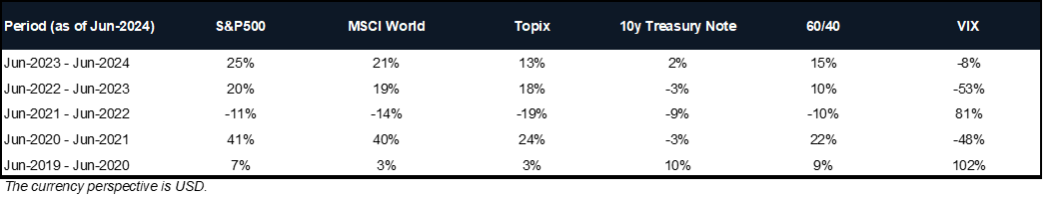
MARKET PULSE: SEPTEMBER 2024
Important Information
Chart Source: St. Louis Federal Reserve. As of July 31, 2024. Chart shows the unemployment rate and job openings rate from June 2009 through June 2024. Each plot reflects the unemployment rate (x-axis) and job openings rate (y-axis) for each month of data.
Price targets of major asset classes are provided by Goldman Sachs Global Investment Research. Source: “Global equities, up 2.4% in August, are making new highs” – September 2, 2024.
Page 1 Definitions
GIR refers to Goldman Sachs Global Investment Research
GDP refers to gross domestic product
Fed refers to the Federal Reserve
Bps refers to basis points
FOMC refers to the Federal Open Market Committee
AI refers to artificial intelligence
Levered ETF refers to a leveraged exchange traded fund that uses financial derivatives and debt to amplify the returns of an underlying index
August 5th daily volume and liquidity according to Goldman Sachs Global Markets
Page 2 Notes
Top Section Notes: Chart shows the daily percentage change of the TOPIX Index from January 21, 1976 to August 28, 2024 . It highlights the biggest drawdowns including a 15% drop on October 20, 1987 and a 12% decline on August 5, 2024.
Middle Section Notes: Chart shows the year-over-year percentage change in nominal GDP growth for the US, Euro Area, United Kingdom, and Japan. The chart compares historical annual growth rates from 2010-2019 with projections from Goldman Sachs Investment Research (GIR) for 2025. This chart emphasizes regional economic outlooks and potential growth trajectories, particularly in Japan.
Bottom Section Notes: Chart shows the evolution of corporate governance in Japan by comparing the Price-to-Book (P/B) value, share buybacks in trillions of yen, and the number of cross-shareholding issues between 2012, 2019, and the latest available data. The chart communicates the impact that governance reforms have on corporate value and shareholder returns, which reflects an ongoing shift towards increased corporate transparency and efficiency.
Index Benchmarks
The S&P 500 Index is the Standard & Poor's 500 Composite Stock Prices Index of 500 stocks, an unmanaged index of common stock prices. The index figures do not reflect any deduction for fees, expenses or taxes. It is not possible to invest directly in an unmanaged index.
The Nasdaq Composite Index is a broad-based market index that includes more than 3700 stocks listed on the Nasdaq stock exchange.
The STOXX Europe 600 Index is derived from the STOXX Europe Total Market Index (TMI) and is a subset of the STOXX Global 1800 Index. With a fixed number of 600 components, the STOXX Europe 600 Index represents large, mid and small capitalization companies across 18 countries of the European region.
The Japan TOPIX Index is a capitalization-weighted index of the largest companies and corporations that are found in the First Section of the Tokyo Stock Exchange.
The Russell 2000 Index measures the performance of the small-cap segment of the US equity universe. The Russell 2000 Index is a subset of the Russell 3000 Index representing approximately 10% of the total market capitalization of that index. It includes approximately 2000 of the smallest securities based on a combination of their market cap and current index membership.
The MSCI AC Asia ex Japan Index captures large and mid cap representation across 2 of 3 DM countries (excluding Japan) and 8 EM countries in Asia.
Risk Considerations
Equity securities are more volatile than bonds and subject to greater risks. Foreign and emerging markets investments may be more volatile and less liquid than investments in US securities and are subject to the risks of currency fluctuations and adverse economic or political developments. Investments in commodities may be affected by changes in overall market movements, commodity index volatility, changes in interest rates or factors affecting a particular industry or commodity. The currency market affords investors a substantial degree of leverage. This leverage presents the potential for substantial profits but also entails a high degree of risk including the risk that losses may be similarly substantial. Currency fluctuations will also affect the value of an investment.
Investments in fixed income securities are subject to the risks associated with debt securities generally, including credit, liquidity, interest rate, prepayment and extension risk. Bond prices fluctuate inversely to changes in interest rates. Therefore, a general rise in interest rates can result in the decline in the bond’s price. The value of securities with variable and floating interest rates are generally less sensitive to interest rate changes than securities with fixed interest rates. Variable and floating rate securities may decline in value if interest rates do not move as expected. Conversely, variable and floating rate securities will not generally rise in value if market interest rates decline. Credit risk is the risk that an issuer will default on payments of interest and principal. Credit risk is higher when investing in high yield bonds, also known as junk bonds. Prepayment risk is the risk that the issuer of a security may pay off principal more quickly than originally anticipated. Extension risk is the risk that the issuer of a security may pay off principal more slowly than originally anticipated. All fixed income investments may be worth less than their original cost upon redemption or maturity.
International securities may be more volatile and less liquid and are subject to the risks of adverse economic or political developments. International securities are subject to greater risk of loss as a result of, but not limited to, the following: inadequate regulations, volatile securities markets, adverse exchange rates, and social, political, military, regulatory, economic or environmental developments, or natural disasters.
When interest rates increase, fixed income securities will generally decline in value. Fluctuations in interest rates may also affect the yield and liquidity of fixed income securities.
Performance Data
FOR INSTITUTIONAL OR FINANCIAL INTERMEDIARIES USE ONLY – NOT FOR USE AND/OR DISTRIBUTION TO THE GENERAL PUBLIC

Slide 4
MARKET PULSE: SEPTEMBER 2024
General Disclosures
EU: This marketing communication is disseminated by Goldman Sachs Asset Management B.V., including through its branches (“GSAM BV”). GSAM BV is authorised and regulated by the Dutch Authority for the Financial Markets (Autoriteit Financiële Markten, Vijzelgracht 50, 1017 HS Amsterdam, The Netherlands) as an alternative investment fund manager (“AIFM”) as well as a manager of undertakings for collective investment in transferable securities (“UCITS”). Under its licence as an AIFM, the Manager is authorized to provide the investment services of (i) reception and transmission of orders in financial instruments; (ii) portfolio management; and (iii) investment advice. Under its licence as a manager of UCITS, the Manager is authorized to provide the investment services of (i) portfolio management; and (ii) investment advice. Information about investor rights and collective redress mechanisms are available on www.gsam.com/responsible-investing (section Policies & Governance). Capital is at risk. Any claims arising out of or in connection with the terms and conditions of this disclaimer are governed by Dutch law.
France: For professional use only (within the meaning of the mifid directive)- not for public distribution. This document is provided for specific information purposes only in order to enable the recipient to assess the financial characteristics of the concerned financial instrument(s) as provided for in article l. 533-13-1, i, 2° of the French monetary and financial code and does not constitute and may not be used as marketing material for investors or potential investors in France.
UK: This material is a financial promotion and has been approved by Goldman Sachs Asset Management International, which is authorized and regulated in the United Kingdom by the Financial Conduct Authority.
Switzerland: For Qualified Investor use only – Not for offering or advertising to general public. This is marketing material. This document is provided to you by Goldman Sachs Bank AG, Zürich. Any future contractual relationships will be entered into with affiliates of Goldman Sachs Bank AG, which are domiciled outside of Switzerland. We would like to remind you that foreign (Non-Swiss) legal and regulatory systems may not provide the same level of protection in relation to client confidentiality and data protection as offered to you by Swiss law.
Bahrain: This material has not been reviewed by the Central Bank of Bahrain (CBB) and the CBB takes no responsibility for the accuracy of the statements, or the information contained herein, or for the performance of the securities or related investment, nor shall the CBB have any liability to any person for damage or loss resulting from reliance on any statement or information contained herein. This material will not be issued, passed to, or made available to the public generally.
Kuwait: This material has not been approved for distribution in the State of Kuwait by the Ministry of Commerce and Industry or the Central Bank of Kuwait or any other relevant Kuwaiti government agency. The distribution of this material is, therefore, restricted in accordance with law no. 31 of 1990 and law no. 7 of 2010, as amended. No private or public offering of securities is being made in the State of Kuwait, and no agreement relating to the sale of any securities will be concluded in the State of Kuwait. No marketing, solicitation or inducement activities are being used to offer or market securities in the State of Kuwait.
Oman: The Capital Market Authority of the Sultanate of Oman (the "CMA") is not liable for the correctness or adequacy of information provided in this document or for identifying whether or not the services contemplated within this document are appropriate investment for a potential investor. The CMA shall also not be liable for any damage or loss resulting from reliance placed on the document.
Qatar: This document has not been, and will not be, registered with or reviewed or approved by the Qatar Financial Markets Authority, the Qatar Financial Centre Regulatory Authority or Qatar Central Bank and may not be publicly distributed. It is not for general circulation in the State of Qatar and may not be reproduced or used for any other purpose.
UAE: This document has not been approved by or filed with the Central Bank of the United Arab Emirates or the Securities and Commodities Authority. If you do not understand the contents of this document, you should consult with a financial advisor.
Saudi Arabia: The Capital Market Authority does not make any representation as to the accuracy or completeness of this document, and expressly disclaims any liability whatsoever for any loss arising from, or incurred in reliance upon, any part of this document. If you do not understand the contents of this document you should consult an authorised financial adviser.
South Africa: Goldman Sachs Asset Management International is authorised by the Financial Services Board of South Africa as a financial services provider.
Israel: This document has not been, and will not be, registered with or reviewed or approved by the Israel Securities Authority (ISA”). It is not for general circulation in Israel and may not be reproduced or used for any other purpose. Goldman Sachs Asset Management International is not licensed to provide investment advisory or management services in Israel.
Chile: (i) Este material está sujeto a la Norma General N ° 336 de la Superintendencia de Valores y Seguros de Chile;(ii) Corresponde a valores no inscritos en el Registro de Valores o en el Registro de Valores Extranjeros mantenido por la Superintendencia de Valores y Seguros, los valores sobre los que se basa, no están sujetos a su control; (iii) Dado que estos valores no están registrados, no existe obligación por parte del emisor de entregar información pública sobre estos valores en Chile; Y (iv) Estos valores no podrán ser objeto de oferta pública hasta su inscripción en el correspondiente Registro de Valores.
Asia Pacific: Please note that neither Goldman Sachs Asset Management International nor any other entities involved in the Goldman Sachs Asset Management (GSAM) business maintain any licenses, authorizations or registrations in Asia (other than Japan), except that it conducts businesses (subject to applicable local regulations) in and from the following jurisdictions: Hong Kong, Singapore and Malaysia. This material has been issued for use in or from Hong Kong by Goldman Sachs Asset Management (Hong Kong) Limited, in or from Singapore by Goldman Sachs Asset Management (Singapore) Pte. Ltd. (Company Number: 201329851H) and in or from Malaysia by Goldman Sachs (Malaysia) Sdn Berhad (880767W).
Brunei: The attached information has been provided at your request for informational purposes only and is not intended as a solicitation in respect of the purchase or sale of instruments or securities (including funds) or the provision of services. Neither Goldman Sachs Asset Management (Singapore) Pte. Ltd. nor any of its affiliates is licensed as a dealer or investment advisor under the Securities Order of Brunei. The information has been provided to you solely for your own purposes and must not be copied or redistributed to any person without the prior consent of Goldman Sachs Asset Management.
East Timor: The attached information has been provided at your request for informational purposes only and is not intended as a solicitation in respect of the purchase or sale of instruments or securities (including funds), or the provision of services. Neither Goldman Sachs Asset Management (Singapore) Pte. Ltd. nor any of its affiliates is licensed under any laws or regulations of Timor-Leste. The information has been provided to you solely for your own purposes and must not be copied or redistributed to any person or institution without the prior consent of Goldman Sachs Asset Management.
Singapore: This material has been issued or approved for use in or from Singapore by Goldman Sachs Asset Management (Singapore) Pte. Ltd. (Company Number: 201329851H).
Colombia: Esta presentación no tiene el propósito o el efecto de iniciar, directa o indirectamente, la adquisición de un producto a prestación de un servicio por parte de Goldman Sachs Asset Management a residentes colombianos. Los productos y/o servicios de Goldman Sachs Asset Management no podrán ser ofrecidos ni promocionados en Colombia o a residentes Colombianos a menos que dicha oferta y promoción se lleve a cabo en cumplimiento del Decreto 2555 de 2010 y las otras reglas y regulaciones aplicables en materia de promoción de productos y/o servicios financieros y /o del mercado de valores en Colombia o a residentes colombianos. Al recibir esta presentación, y en caso que se decida contactar a Goldman Sachs Asset Management, cada destinatario residente en Colombia reconoce y acepta que ha contactado a Goldman Sachs Asset Management por su propia iniciativa y no como resultado de cualquier promoción o publicidad por parte de Goldman Sachs Asset Management o cualquiera de sus agentes o representantes. Los residentes colombianos reconocen que (1) la recepción de esta presentación no constituye una solicitud de los productos y/o servicios de Goldman Sachs Asset Management, y (2) que no están recibiendo ninguna oferta o promoción directa o indirecta de productos y/o servicios financieros y/o del mercado de valores por parte de Goldman Sachs Asset Management. Esta presentación es estrictamente privada y confidencial, y no podrá ser reproducida o utilizada para cualquier propósito diferente a la evaluación de una inversión potencial en los productos de Goldman Sachs Asset Management o la contratación de sus servicios por parte del destinatario de esta presentación, no podrá ser proporcionada a una persona diferente del destinatario de esta presentación.
This material is provided at your request for informational purposes only. It is not an offer or solicitation to buy or sell any securities.
Goldman Sachs Asset Management leverages the resources of Goldman Sachs & Co. LLC subject to legal, internal and regulatory restrictions.
FOR INSTITUTIONAL OR FINANCIAL INTERMEDIARIES USE ONLY – NOT FOR USE AND/OR DISTRIBUTION TO THE GENERAL PUBLIC

Slide 5
MARKET PULSE: SEPTEMBER 2024
Emerging markets investments may be less liquid and are subject to greater risk than developed market investments as a result of, but not limited to, the following: inadequate regulations, volatile securities markets, adverse exchange rates, and social, political, military, regulatory, economic or environmental developments, or natural disasters.
Commodities greater volatility than investments in traditional securities. Investments in commodities may be affected by changes in overall market movements, changes in interest rates, or factors affecting a particular industry or commodity. Commodities are also subject to social, political, military, regulatory, economic, environmental or natural disaster risks.
The risk of foreign currency exchange rate fluctuations may cause the value of securities denominated in such foreign currency to decline in value. Currency exchange rates may fluctuate significantly over short periods of time. These risks may be more pronounced for investments in securities of issuers located in, or otherwise economically tied to, emerging countries. If applicable, investment techniques used to attempt to reduce the risk of currency movements (hedging), may not be effective. Hedging also involves additional risks associated with derivatives.
General Disclosures
This information discusses general market activity, industry or sector trends, or other broad-based economic, market or political conditions and should not be construed as research or investment advice. This material has been prepared by Goldman Sachs Asset Management and is not financial research nor a product of Goldman Sachs Global Investment Research (GIR). It was not prepared in compliance with applicable provisions of law designed to promote the independence of financial analysis and is not subject to a prohibition on trading following the distribution of financial research. The views and opinions expressed may differ from those of Goldman Sachs Global Investment Research or other departments or divisions of Goldman Sachs and its affiliates. Investors are urged to consult with their financial advisors before buying or selling any securities. This information may not be current and Goldman Sachs Asset Management has no obligation to provide any updates or changes.
Indices are unmanaged. The figures for the index reflect the reinvestment of all income or dividends, but do not reflect the deduction of any fees or expenses which would reduce returns. Investors cannot invest directly in indices.
Any reference to a specific company or security does not constitute a recommendation to buy, sell, hold or directly invest in the company or its securities. It should not be assumed that investment decisions made in the future will be profitable or will equal the performance of the securities discussed in this document.
Neither MSCI nor any other party involved in or related to compiling, computing, or creating the MSCI data makes any express or implied warranties or representations with respect to such data (or the results to be obtained by the use thereof), and all such parties hereby expressly disclaim all warranties of originality, accuracy, completeness, merchantability, or fitness for a particular purpose with respect to any of such data. Without limiting any of the foregoing, in no event shall MSCI, any of its affiliates or any third party involved in or related to compiling, computing or creating the data have any liability for any direct, indirect, special, punitive, consequential or any other damages (including lost profits) even if notified of the possibility of such damages. No further distribution or dissemination of the MSCI data is permitted without MSCI’s express written consent.
Views and opinions expressed are for informational purposes only and do not constitute a recommendation by Goldman Sachs Asset Management to buy, sell, or hold any security, including any Goldman Sachs product or service.
Views and opinions are current as of the date of this document and may be subject to change, they should not be construed as investment advice.
Although certain information has been obtained from sources believed to be reliable, we do not guarantee its accuracy, completeness or fairness. We have relied upon and assumed without independent verification, the accuracy and completeness of all information available from public sources.
Economic and market forecasts presented herein reflect a series of assumptions and judgments as of the date of this document and are subject to change without notice. These forecasts do not take into account the specific investment objectives, restrictions, tax and financial situation or other needs of any specific client. Actual data will vary and may not be reflected here. These forecasts are subject to high levels of uncertainty that may affect actual performance. Accordingly, these forecasts should be viewed as merely representative of a broad range of possible outcomes. These forecasts are estimated, based on assumptions, and are subject to significant revision and may change materially as economic and market conditions change. Goldman Sachs has no obligation to provide updates or changes to these forecasts. Case studies and examples are for illustrative purposes only.
Valuation levels for the assets listed in the Account statements and other documents containing prices reflect Goldman Sachs Asset Management’s good faith effort to ascertain fair market levels (including accrued income, if any) for all positions. Third party pricing services generally value fixed income securities assuming orderly transactions of an institutional round lot size, but accounts may hold or transact in such securities in smaller odd lot sizes. Odd lots may trade at lower prices than institutional round lots. The valuation information is believed by Goldman Sachs Asset Management to be reliable for round lot sizes. The prices are indicative only of the assumed fair value of the positions on the relevant date. These valuation levels may not be realized by the Account upon liquidation. Market conditions and transaction size will affect liquidity and price received upon liquidation. Current exchange rates will be applied in valuing positions in foreign currency.
For portfolio valuation purposes it is the responsibility of the custodian, administrator or such other third party appointed by the client, to obtain accurate and reliable information concerning the valuation of any securities including derivative instruments which are comprised in the portfolio. The information that Goldman Sachs Asset Management provides should not be deemed the official pricing and valuation for the Account. Goldman Sachs Asset Management is not obligated to provide pricing information to satisfy any regulatory, tax or accounting requirements to which the Client may be subject.
THIS MATERIAL DOES NOT CONSTITUTE AN OFFER OR SOLICITATION IN ANY JURISDICTION WHERE OR TO ANY PERSON TO WHOM IT WOULD BE UNAUTHORIZED OR UNLAWFUL TO DO SO. Prospective investors should inform themselves as to any applicable legal requirements and taxation and exchange control regulations in the countries of their citizenship, residence or domicile which might be relevant.
This material is provided at your request solely for your use.
Past performance does not guarantee future results, which may vary. The value of investments and the income derived from investments will fluctuate and can go down as well as up. A loss of principal may occur.
Confidentiality No part of this material may, without Goldman Sachs Asset Management’s prior written consent, be (i) copied, photocopied or duplicated in any form, by any means, or (ii) distributed to any person that is not an employee, officer, director, or authorized agent of the recipient.
© 2024 Goldman Sachs. All rights reserved. Compliance code: 386501-OTU-2099360. Date of First Use: 04 September 2024.
AEJ - 350474-TMPL-01/2024-1938665 / EMEA - 350699-TMPL-01/2024-1939478 / LATAM - 351333-TMPL-01/2024-1942542 For more information contact your Goldman Sachs sales representative.
MPSEP2024
FOR INSTITUTIONAL OR FINANCIAL INTERMEDIARIES USE ONLY – NOT FOR USE AND/OR DISTRIBUTION TO THE GENERAL PUBLIC

